Slide 1



Development of an Autonomous Drone for Aerial and Deep-Sea Operations
Sidharth Sreedas Nambiar (s4061315 )
Mohan Senthil (s4145582 )
Dharson Raju Mariappan (s4137396 )
Raghul Chinnathambi (s4146093 )
Wanninayaka Mudiyanselage Janith Bandara Wanninayaka (s4153605 )

Slide 2
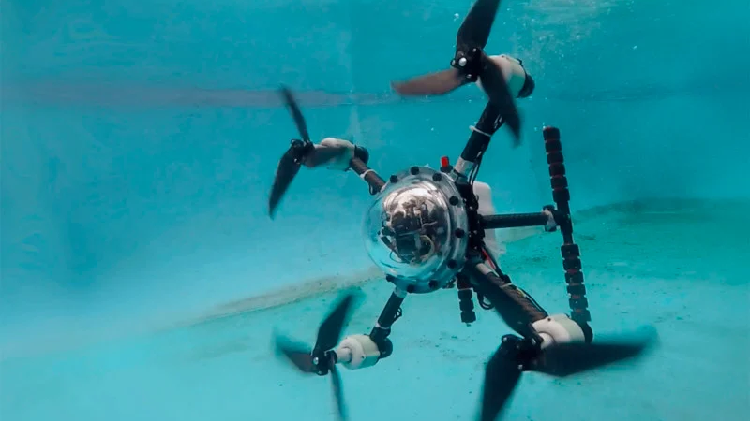
Introduction
Drones designed for both aerial and underwater operations represent a cutting-edge advancement in unmanned systems. These hybrid platforms are built to seamlessly transition between flying in the air and navigating underwater, enabling a wide range of applications. Operating in such contrasting environments poses unique engineering challenges. These drones must be lightweight for flight yet durable enough to withstand deep-sea pressure. Their ability to adapt across domains offers new levels of operational flexibility in both civilian and military sectors.

Slide 3
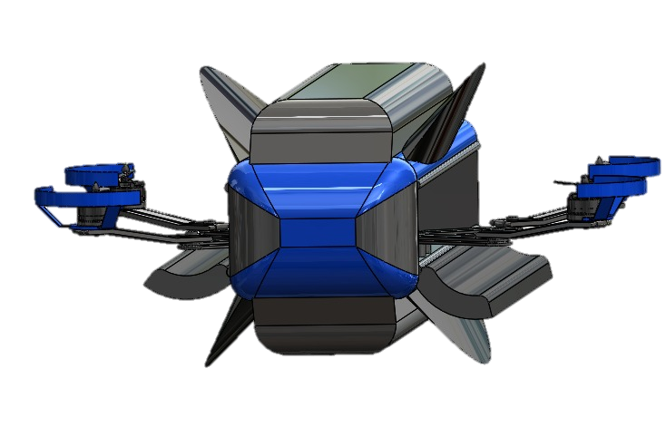
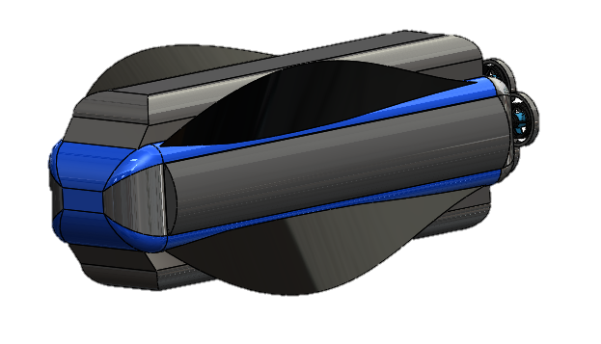
Design Overview
INSIDE WATER
AIR

Slide 4
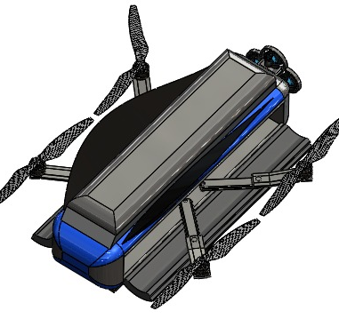
Key Design Changes
Larger Propellers→ Increased lift for smoother and more efficient takeoff
Split Propeller Design→ Two-part propellers allow compact folding for better space optimization.
Nitinol Wing Mechanism→ Shape-memory alloy enables automatic opening/closing of wing doors using heat.

Slide 5
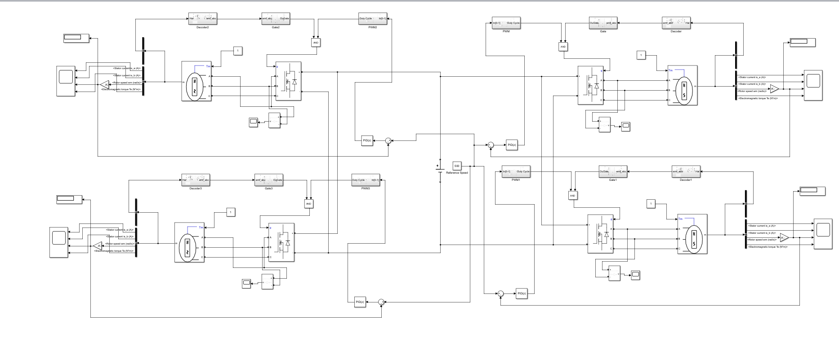
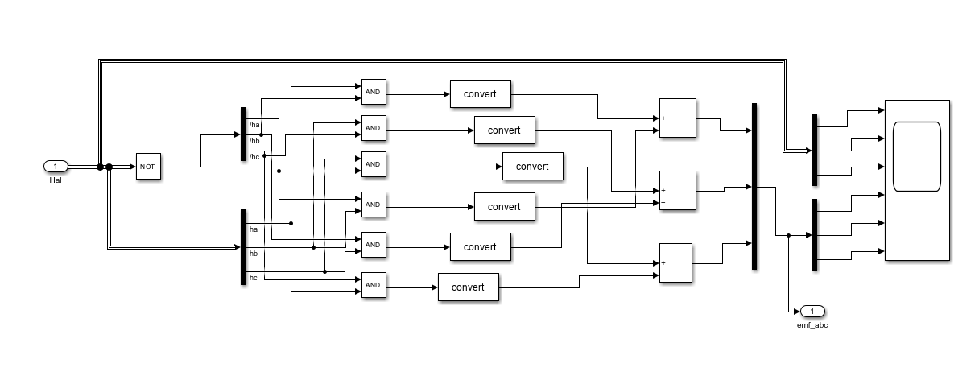
Motor Simulation
Decoder

Slide 6
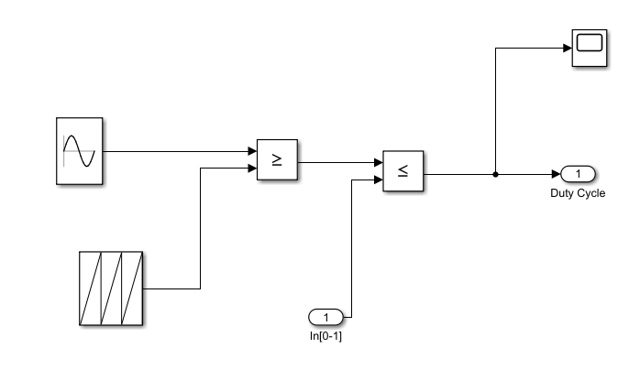
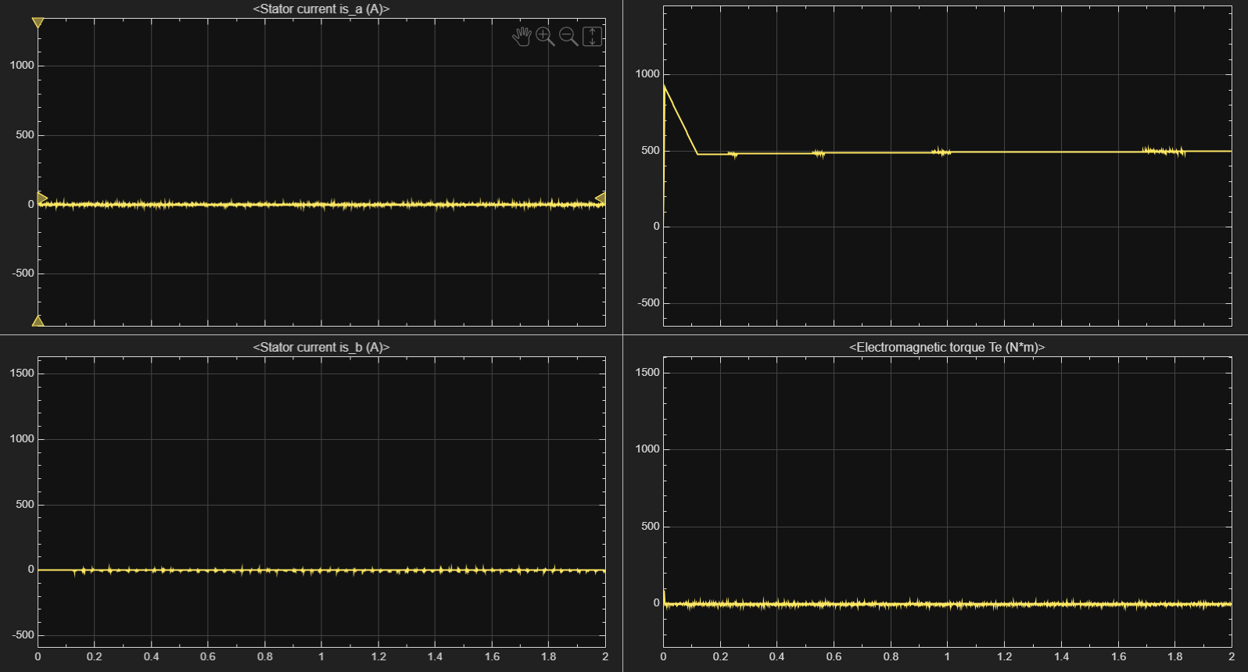
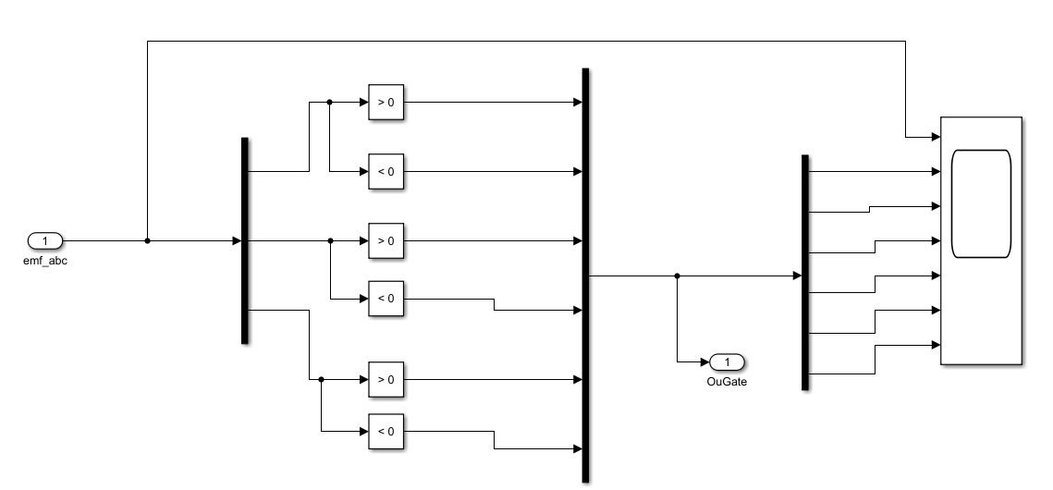
PWM
Gate

Slide 7
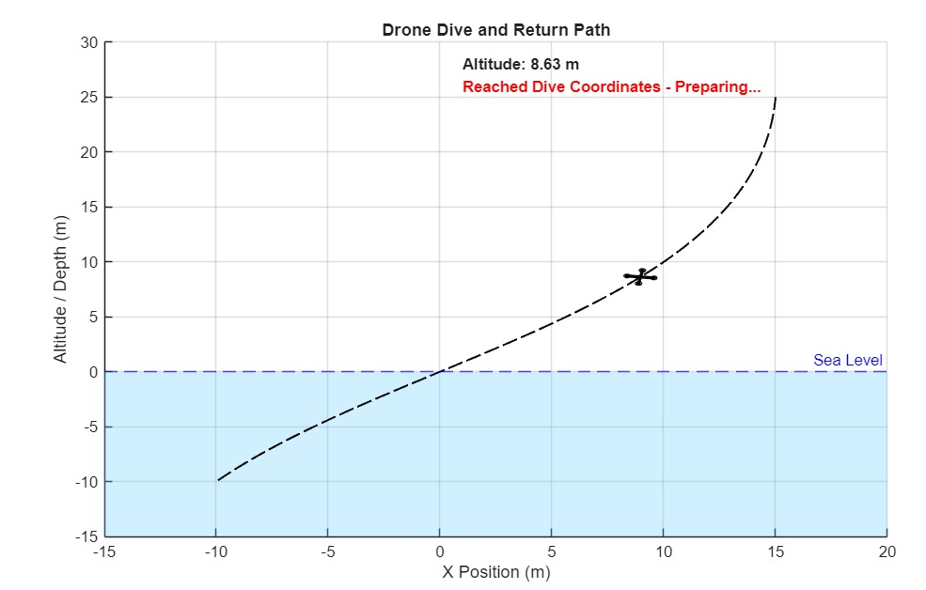
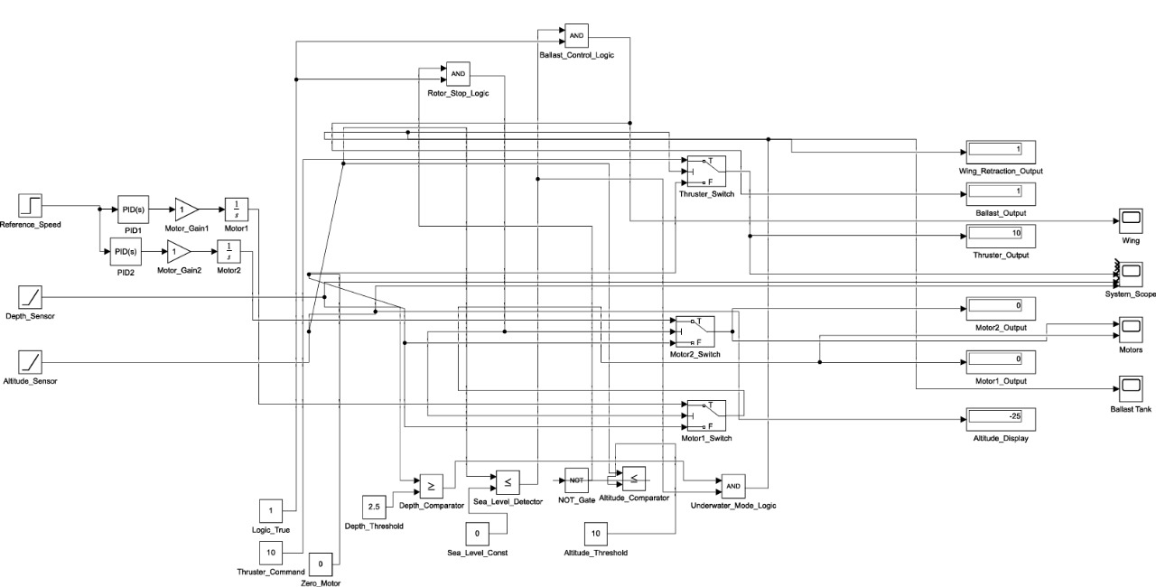
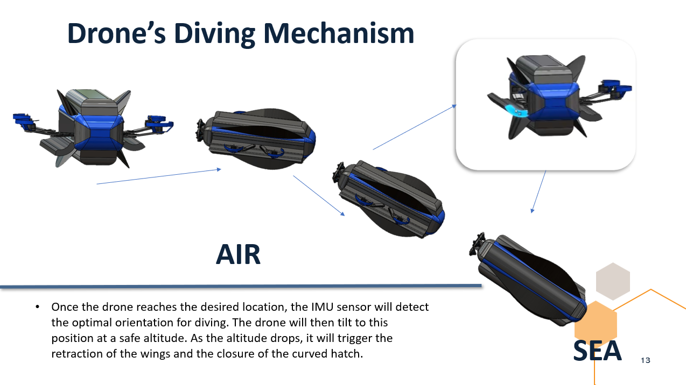
Drone Dive Simulation

Slide 8
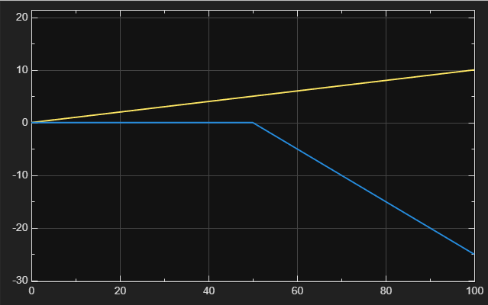
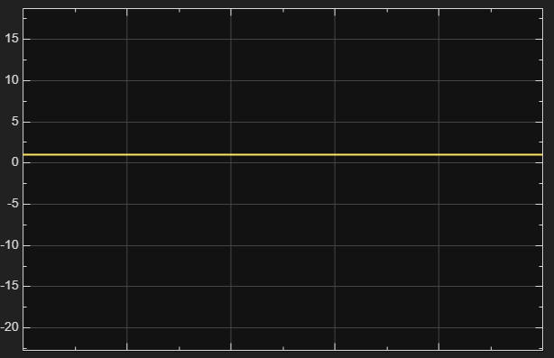
Analysis
Depth Sensor(yellow) Gradually increases after sea entry
Aerial Motors: Active until 10m altitude, then switches OFF.
Ballast Control Signal: Changes from 0 to 1 at sea level (0m).

Slide 9
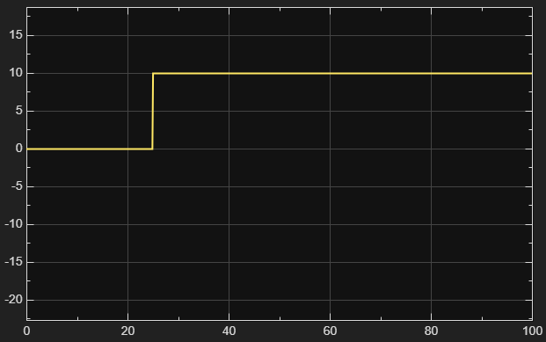
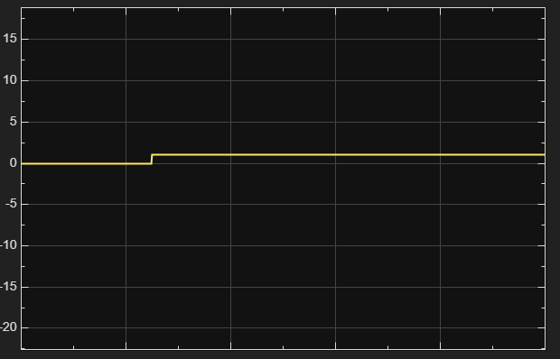
Thruster Output: thruster activates after the drone enters water and reaches a depth > 2.5 meters
Wing Retraction / Underwater Mode: Turns ON 10s after dropping below 10m altitude. Remains ON underwater

Slide 10
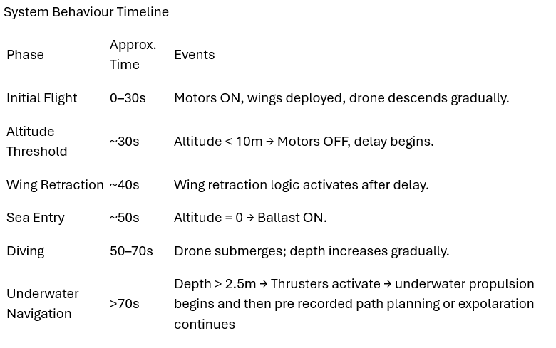
Logical Control
If altitude > 10m → Motors remain ON.
If altitude ≤ 10m → Motors OFF, 10s timer for wing retraction starts.
After timer → Wing retraction activated.
If altitude = 0 → Ballast system activates.
If depth ≥ 2.5m → Underwater thrusters activated.

Slide 11
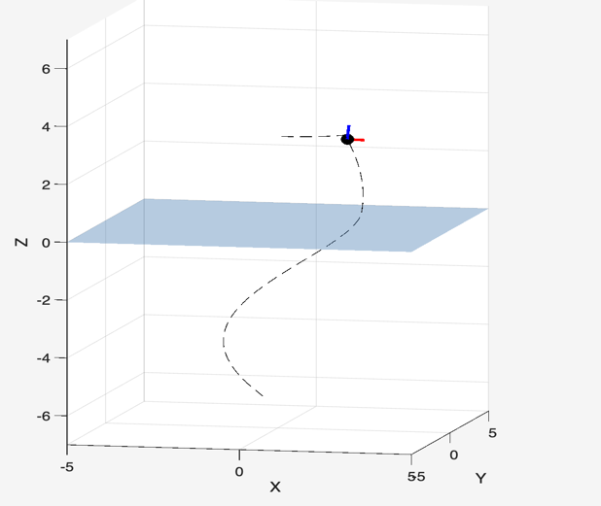
Drone Motion Simulation
Simulation of a dual-mode drone operating in both aerial and underwater environments
MATLAB-based path planning and visualization
Objective: Understand real-time position, transition, and orientation of the drone in different media

Slide 12
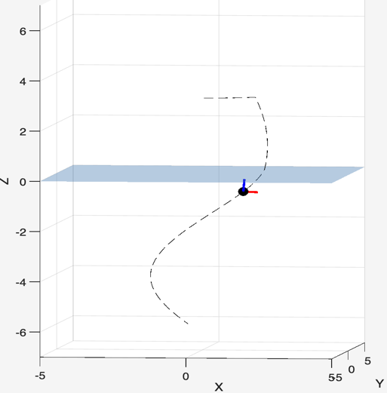
Transition from Air to Water
Controlled descent modeled between two fluid environments
Smooth trajectory design for interface transition
Simulates how sensors and control logic stabilize the drone

Slide 13
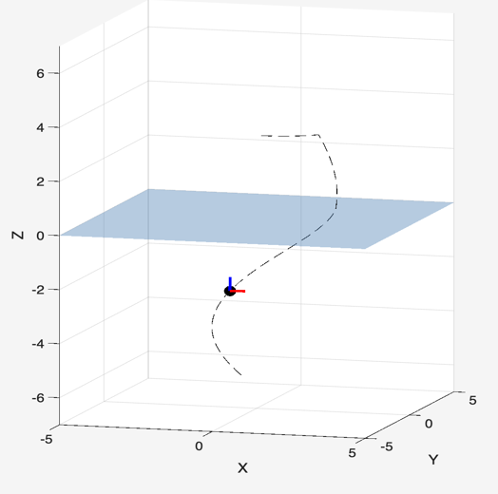
Underwater Navigation Simulation
Simulated underwater navigation
Thruster behavior and stability modeled via orientation indicators
Demonstrates drone adaptability below surface

Slide 14
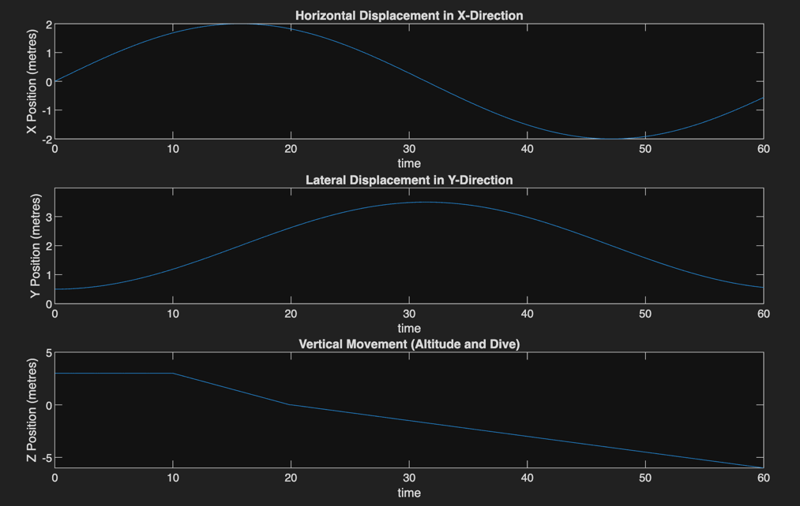
Position vs. Time Graph Analysis
Three subplots: X, Y, Z positions over time
Highlights movement in each spatial dimension
Demonstrates how drone shifts in air and water

Slide 15
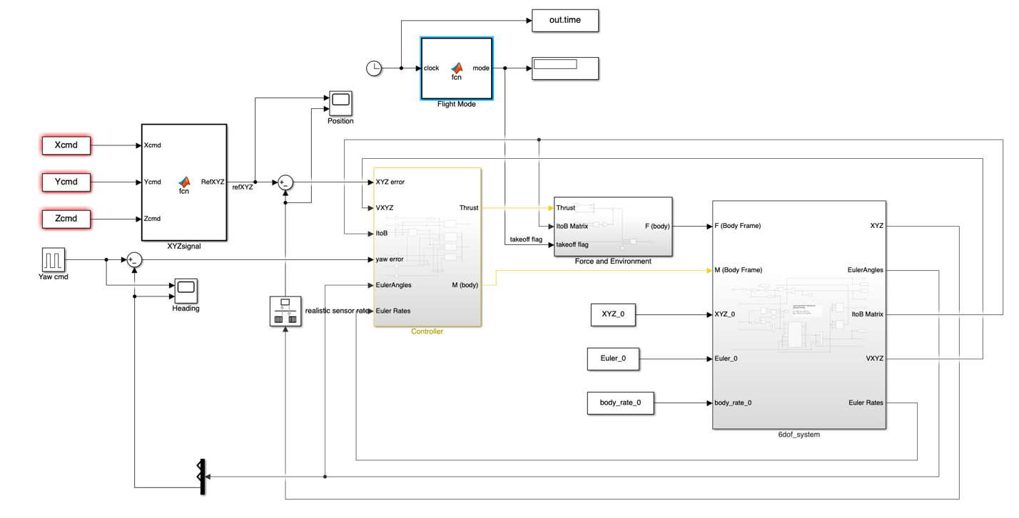
Simulink Control Architecture
Custom Simulink model for motion control
Blocks represent sensor input, PID control, and motor output
Validates system-level behavior

Slide 16
Underwater Simulation and Analysis
Physics-based 3D simulation of an autonomous underwater rover
Realistically models vehicle movement, control, sensor readings, and obstacle avoidance
Designed for analyzing how the rover interacts with a complex aquatic environment
Demonstrates advanced marine robotics concepts in a controlled, virtual setting

Slide 17
System Overview
Environment:
500 m × 500 m × 300 m space with 20 randomly placed spherical obstacles
Drone:
1.59 × 0.57 × 0.63 m, 320 kg, with ballast tank (0–260 kg) for depth control
Four rear thrusters (+ formation), IMU (accelerometer & gyro), and 360° sonar
Control Logic:
PID controllers for heading, speed, and depth
Autonomous waypoint tracking and real-time obstacle avoidance using simulated sensors

Slide 18
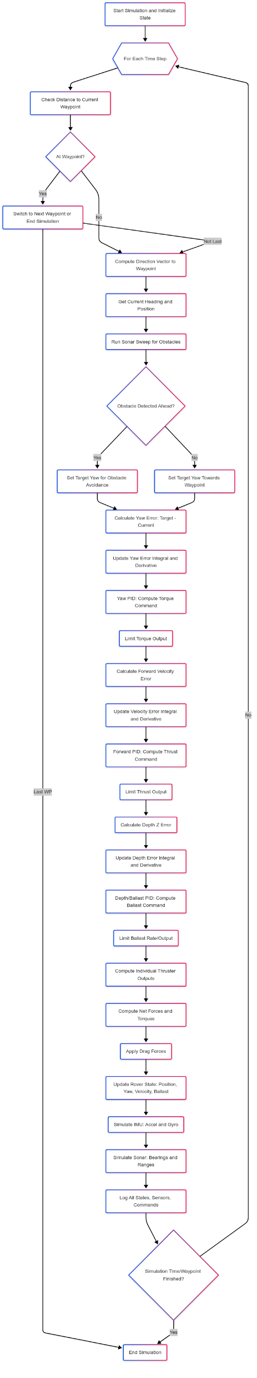
Underwater
Workflow

Slide 19
Simulation in Action – Visual Results
Now ill run the simulation live, Changing way points

Slide 20
Key Insights and Performance
Navigation:
Successfully reaches waypoints while avoiding obstacles and managing depth
Efficient Buoyancy:
Ballast system handles vertical movement, freeing thrusters for horizontal motion
Sensor Realism:
Simulated IMU and sonar data enable robust testing of navigation algorithms
Obstacle Avoidance:
Reliable detection and evasion of obstacles—proving the effectiveness of sensor-driven autonomy

Slide 21
References
Luo, C., Sun, Y., & Yu, J. (2020). Review on underwater and amphibious aerial-aquatic vehicles. Ocean Engineering, 216, 107871. https://doi.org/10.1016/j.oceaneng.2020.107871
Xu, T., Fang, Y., Wang, H., & Ma, G. (2021). A survey of amphibious robots: Solutions and challenges. Journal of Field Robotics, 38(5), 675–697. https://doi.org/10.1002/rob.21974
Sattar, J. (2019). Non-destructive underwater inspection robots: State-of-the-art and future directions. Annual Reviews in Control, 48, 161–175. https://doi.org/10.1016/j.arcontrol.2019.01.003
Bryson, M., Johnson-Roberson, M., Pizarro, O., & Williams, S. B. (2016). Automated registration for multi-year robotic surveys of coral reefs. Proceedings of the IEEE International Conference on Robotics and Automation (ICRA), 2602–2609. https://doi.org/10.1109/ICRA.2016.7487409
He, K., Zhang, X., Ren, S., & Sun, J. (2016). Deep Residual Learning for Image Recognition. Proceedings of the IEEE Conference on Computer Vision and Pattern Recognition (CVPR), 770–778. https://doi.org/10.1109/CVPR.2016.90
Qin, Y., He, C., & Song, B. (2019). A survey of solar-powered unmanned aerial vehicles: Developments and challenges. Renewable and Sustainable Energy Reviews, 106, 274–287. https://doi.org/10.1016/j.rser.2019.02.039
Brambilla, M., Ferrante, E., Birattari, M., & Dorigo, M. (2013). Swarm robotics: A review from the swarm engineering perspective. Swarm Intelligence, 7(1), 1–41. https://doi.org/10.1007/s11721-012-0075-2
Xu, J., Ma, G., & Wang, H. (2019). A review of autonomous underwater vehicle technology and its applications. Ocean Engineering, 175, 33–48. https://doi.org/10.1016/j.oceaneng.2019.02.048
Zhou, C., Xu, Z., Deng, Z., & Liang, Z. (2020). Development of a Hybrid Aerial-Underwater Vehicle: Design, Modeling, and Experiments. IEEE Access, 8, 116450–116461.
Whitt, C., Manley, J., & Hartsfield, B. (2017). Hybrid Aerial-Underwater Vehicles: Recent Progress and Future Prospects. OCEANS 2017 - Anchorage. IEEE.
Rahul, A., & Sanyal, A. (2018). Design Considerations for Aerial and Underwater Drones. International Journal of Robotics and Automation (IJRA), Vol. 7, No. 2, 94-100.

Slide 22
Thank you

